Slide 1
Group Messaging System
Mini-Project

Slide 2
Contents
Introduction
Objectives
Limitations
Software Requirements
I-Node
Design
Byte Vector
Hardware Requirements

Slide 3
Introduction
This project is about how the back end of a group messaging software works. It is a back end program which is dealt with concepts from scratch. This project shows how software in the back end is working and it was an attempt of replicating the real time systems present today.
In many shared environments, such as homes, hospitals or offices, the way messages are left for absent individuals is that they are written down on scrap paper, notepads or sticky notes and left somewhere for the absent person(s) to notice and read at a later time.

Slide 4
Introduction ctd…
Unfortunately, this can lead to communication problems because the messages that are left can be illegible, contain shorthand notations understood only by the message taker, or the message could even be overlooked altogether.

Slide 5
Objectives
To be able to send messages to a group successfully.
To be able to store the data of messages and groups in a file hard core.
To be able to like and comment a message.
To able to structure the groups, messages and comments into uniform blocks.
To be able to comment on comments.
To be able for any user to enter into any groups.
Finally the objective of the project is to give user friendly interface and give the look, feel and experience as close to the real time as possible.

Slide 6
Limitations
This project is limited only to the sending of messages and does not handle the deletion of messages.
It does not provide user authentication i.e. it does not have the facility of checking for password.
It does not have limit in the count of time each user can like a message or comment.

Slide 7
Software Requirements
The software requirements for this project are discussed below in detailed. The project is mostly written or executed in C programming language. We use the following concepts of computer science
C Language.
i-Node (Index Node).
Bit Vector (for storing the Meta Data).
File System.

Slide 8
I-Node
In a Unix-style file system, an index node, informally referred to as an i-node, is a data structure used to represent a file system object, which can be one of various things including a file or a directory.
Each i-node stores the attributes and disk block location of the file system object's data.
File system object attributes may include manipulation metadata , as well as owner and permission data.

Slide 9
I-Node ctd…
The key features of an i-node in this project are give as follows:
Fixed logical block size.
Ease of data location.
Indirect blocks.
Bit Vector : A bit array (also known as bitmap, bit set, bit string, or bit vector) is an array data structure that compactly stores bits. It can be used to implement a simple set data structure. A bit array is effective at exploiting bit-level parallelism in hardware to perform operations quickly.

Slide 10
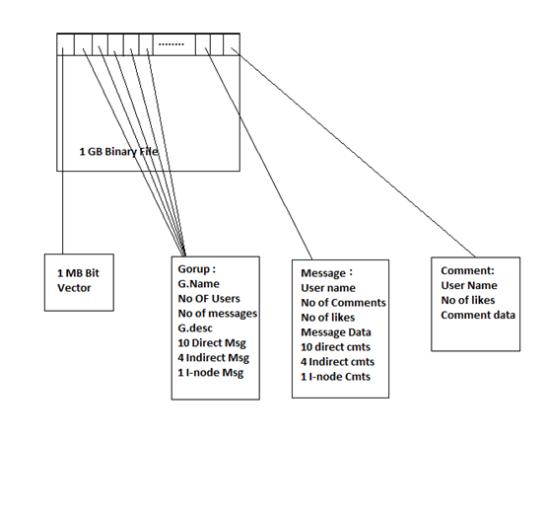
Design

Slide 11
Group Structure
The group in this project is 128 Bytes the size and structure of the Group is given below:
Attributes | Size of the attribute
Group Name | 10 Bytes
No of Users | 4 Bytes
No of Messages | 4 Bytes
Group Description | 50 Bytes
Direct Message Address | 10 x 4 Bytes
Indirect Message Address | 4 x 4 Bytes
I-node Message Address | 4 Bytes
Total | 128 Bytes

Slide 12
Message Structure
The Message in this project is 256 Bytes the size and structure of the Message is given below:
Attributes | Size of the attribute
User Name | 8 Bytes
Message Text | 180 Bytes
No of comments | 4 Bytes
No of Likes | 4 Bytes
Direct Comment Address | 10 x 4 Bytes
Indirect Comment Address | 4 x 4 Bytes
I-node Comment Address | 4 Bytes
Total | 256 Bytes

Slide 13
Comment Structure
The Comment in this project is 128 Bytes the size and structure of the Comment is given below:
Attributes | Size of the Attribute
User Name | 8 Bytes
Comment Text | 116 Bytes
No of Likes | 4 Bytes
Total | 128 Bytes

Slide 14
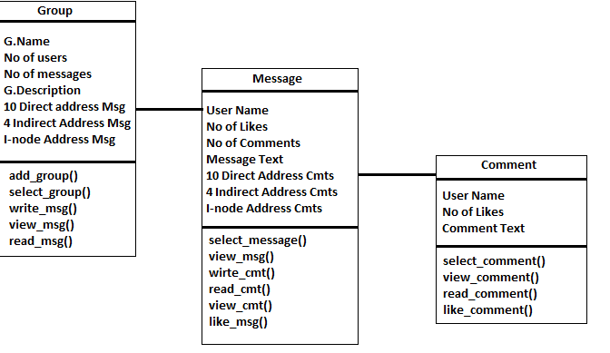
Class Diagram
The class diagram of the design of the project is as follows:

Slide 15
Byte vector function
This function is used to find which block in the file is empty and to find the corresponding block required to retrieve for actions to be performed. The function is coded as follows:
int byte_vector_write(FILE *fp, int flag)
{
char b = "0", *ch, *h = "1";
int i, k;
rewind(fp);
for (i = 0; i < (1024 * 1024 * 8); i++)
{ ch = getc(fp);
if (ch == '0') break;
} i -= 2;

Slide 16
Byte Vector ctd
fseek(fp, -1, 1);
if (flag == 1)
for (k = 0; k < 2; k++)
fwrite((char*)h, strlen(h), 1, fp);
else
fwrite((char*)h, strlen(h), 1, fp);
return i;
}

Slide 17
Hardware Requirements
1GB External Memory.
C language compiler.
512 MB RAM (Random Access Memory).
Multiprocessor.
Greater than 2 GB ROM(Read Only Memory)/Secondary Memory.

Slide 18
References
Wikipedia Website.
Multiple different sources from the web.
http.www.creately.com(for UML Diagrams).

Slide 19
Thank You
By Kandhibedala Lavanya
(CSE-B 2210312227).

